Slide 1
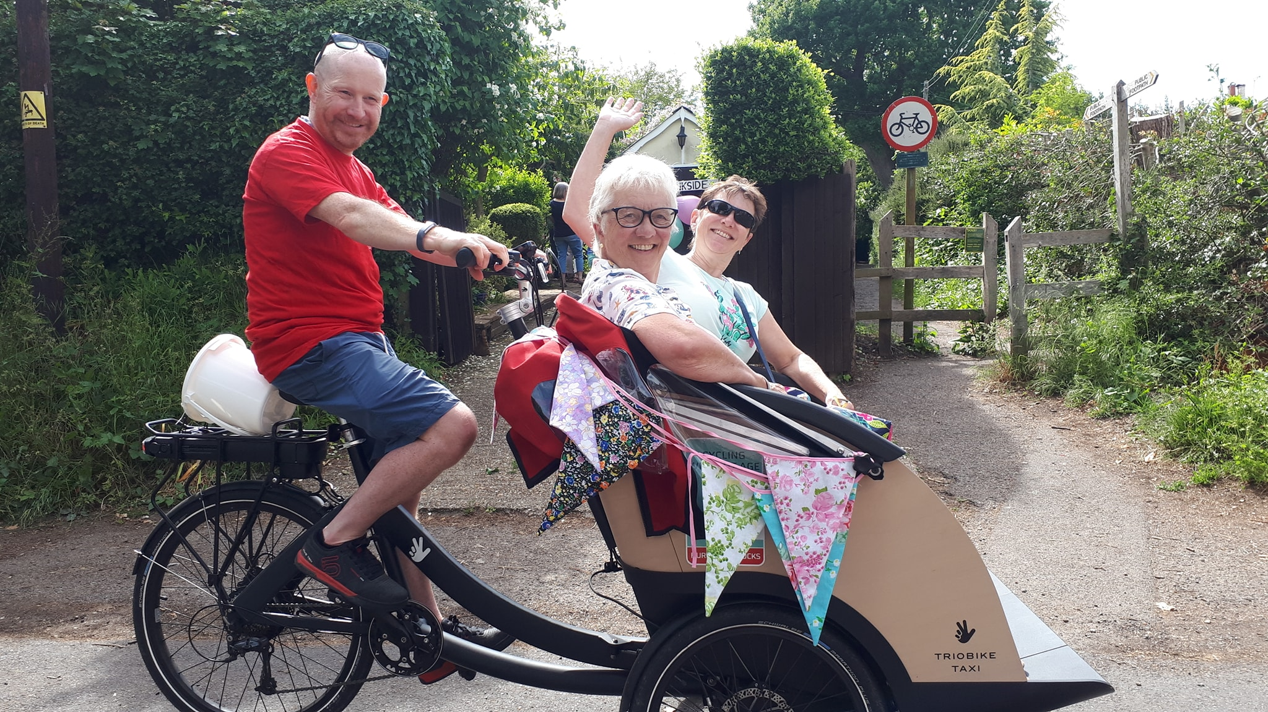
CYCLING WITHOUT AGE
The Right to Wind
In your Hair
Hurst & Hassock

Slide 2
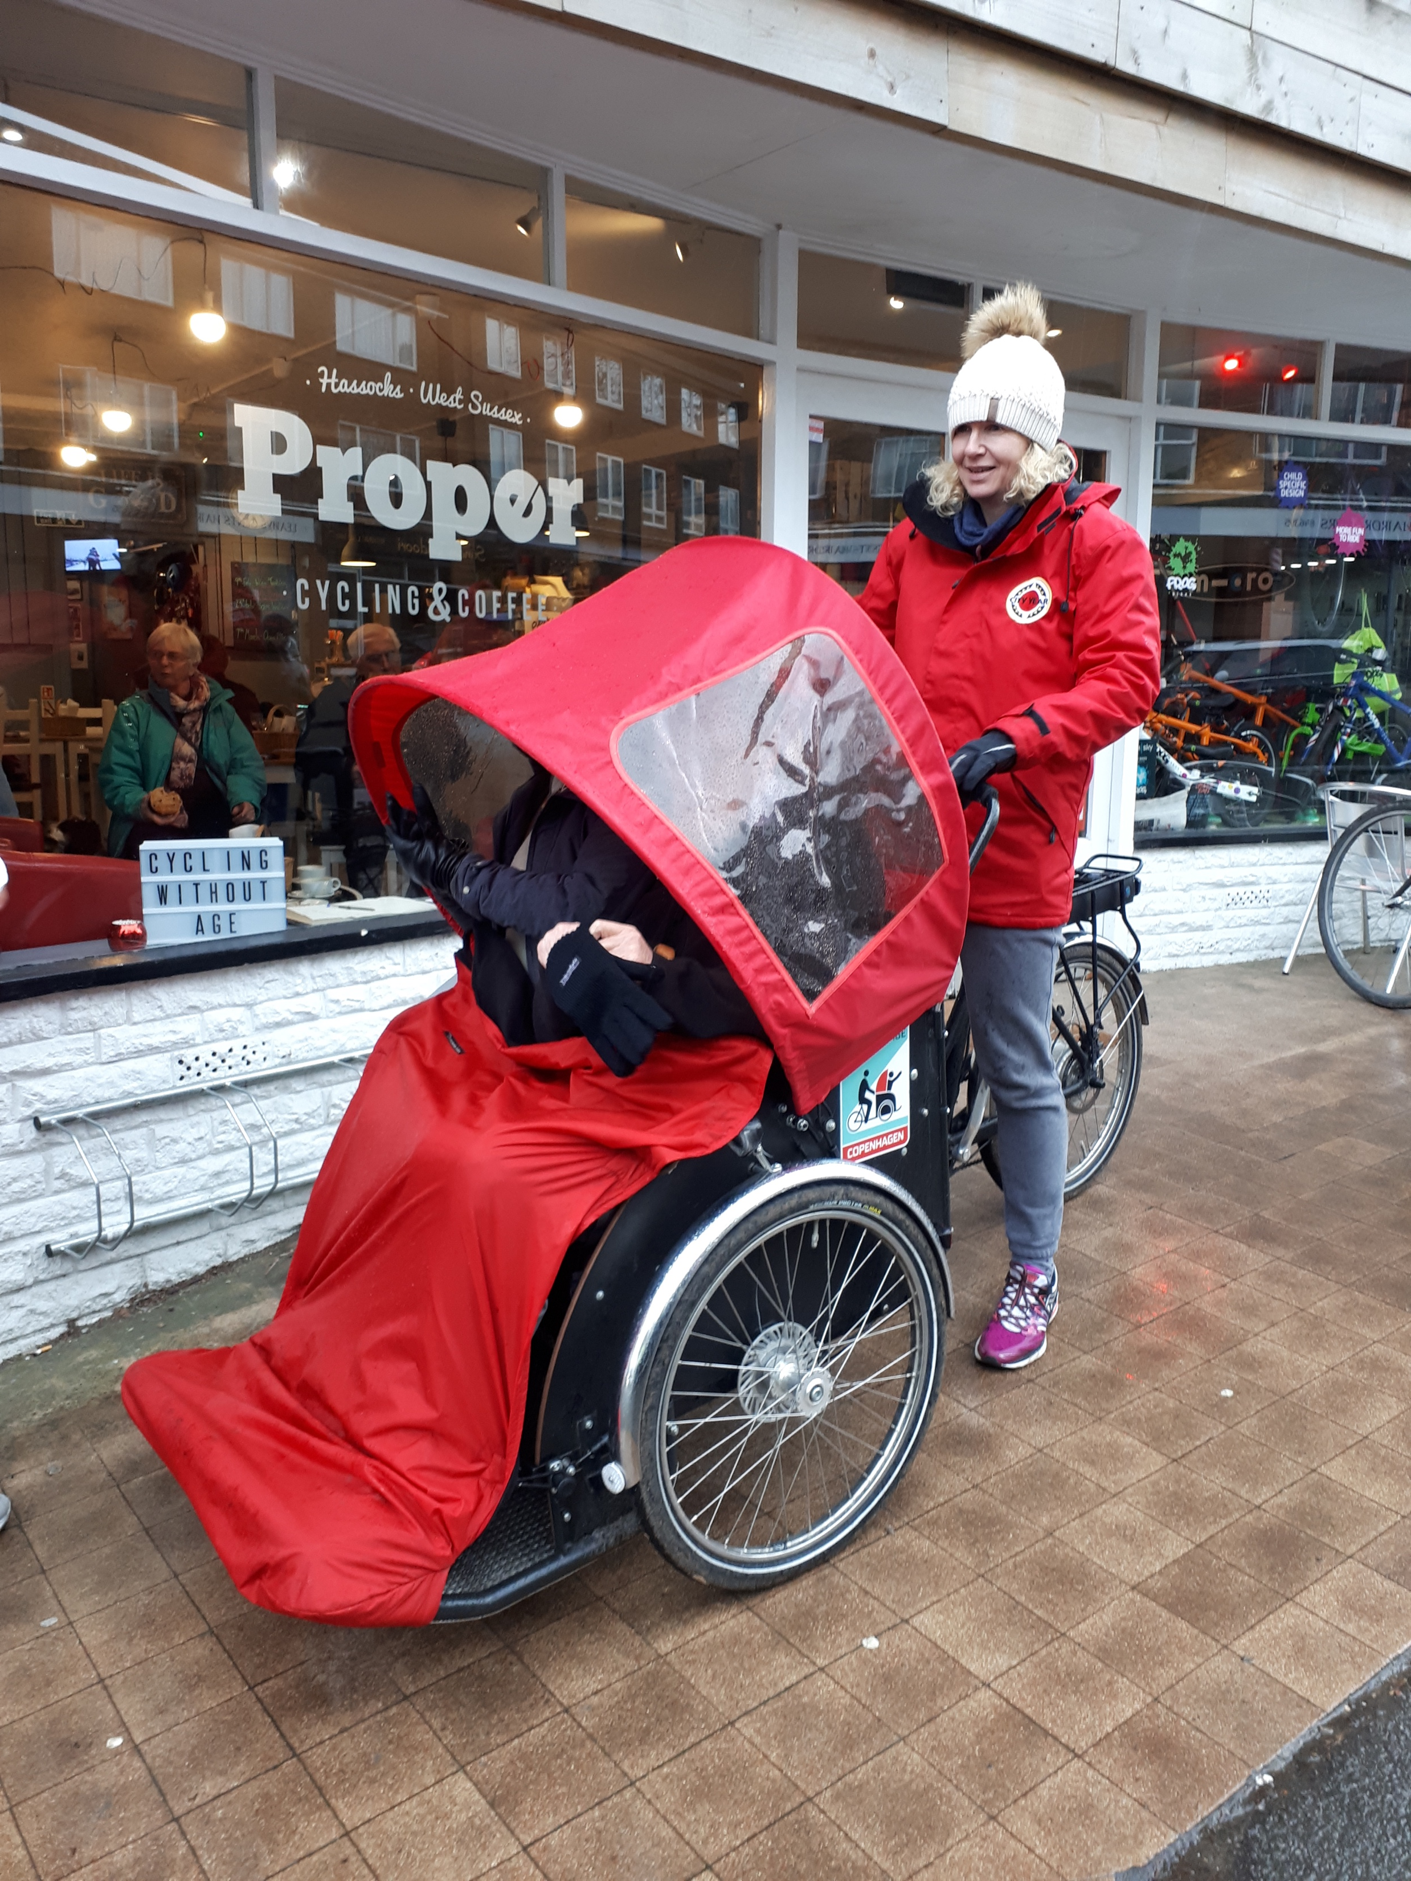
Background
Chapter in Sussex, near Brighton
2 Trishaws funded by local charities
Only one local care homes
Doorstep pickups limited

Slide 3
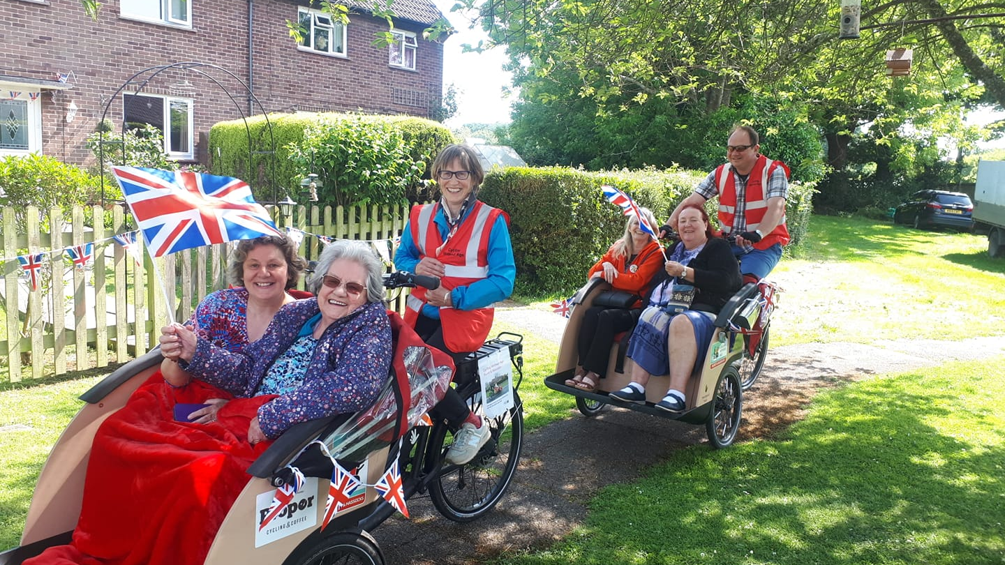

Slide 4
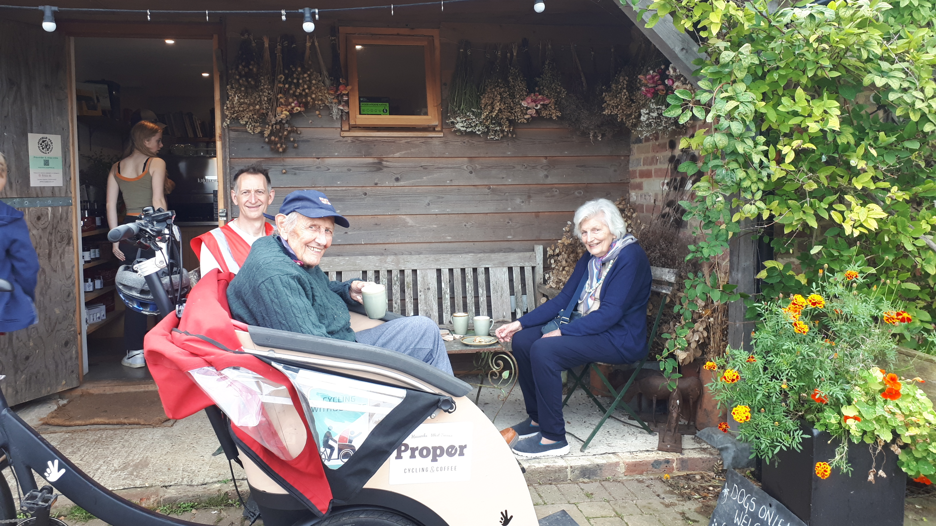

Slide 5
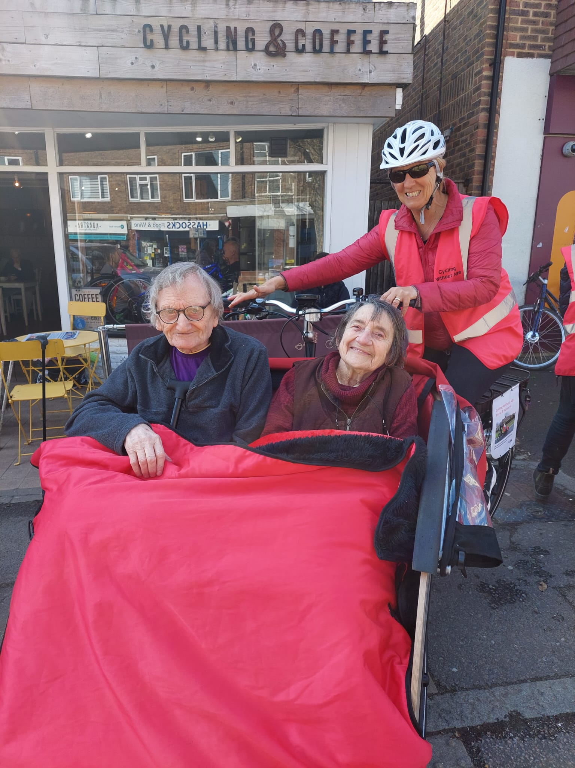
Collaborations with local organisations
Age Concern
Oaks & Acorns
Know Dementia
Social Prescribers
Repair Cafe

Slide 6
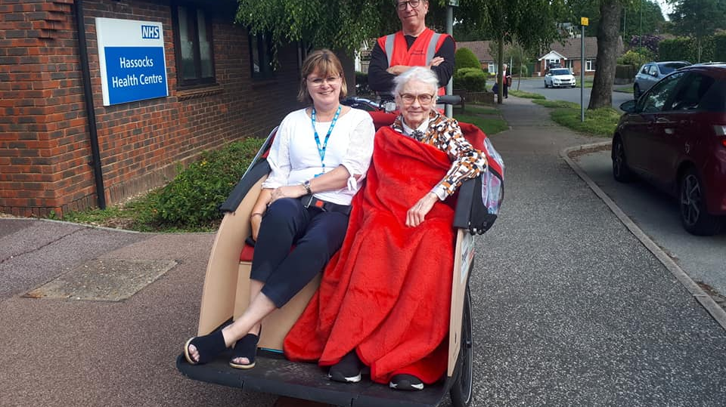

Slide 8
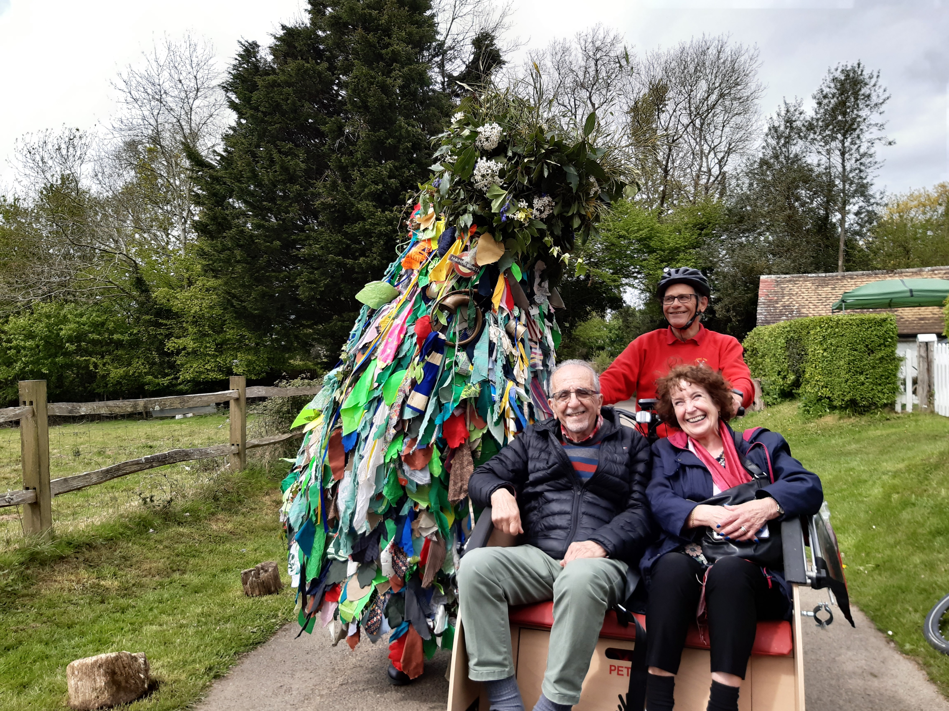
Link ups with local events
Open gardens
Windmill open day
Jumble trail
Village fair parade
Hurst festival
Light Up Hassocks
20 is Plenty campaign
Remembrance Parade
Also:
London & Brighton Naked Bike Ride

Slide 9
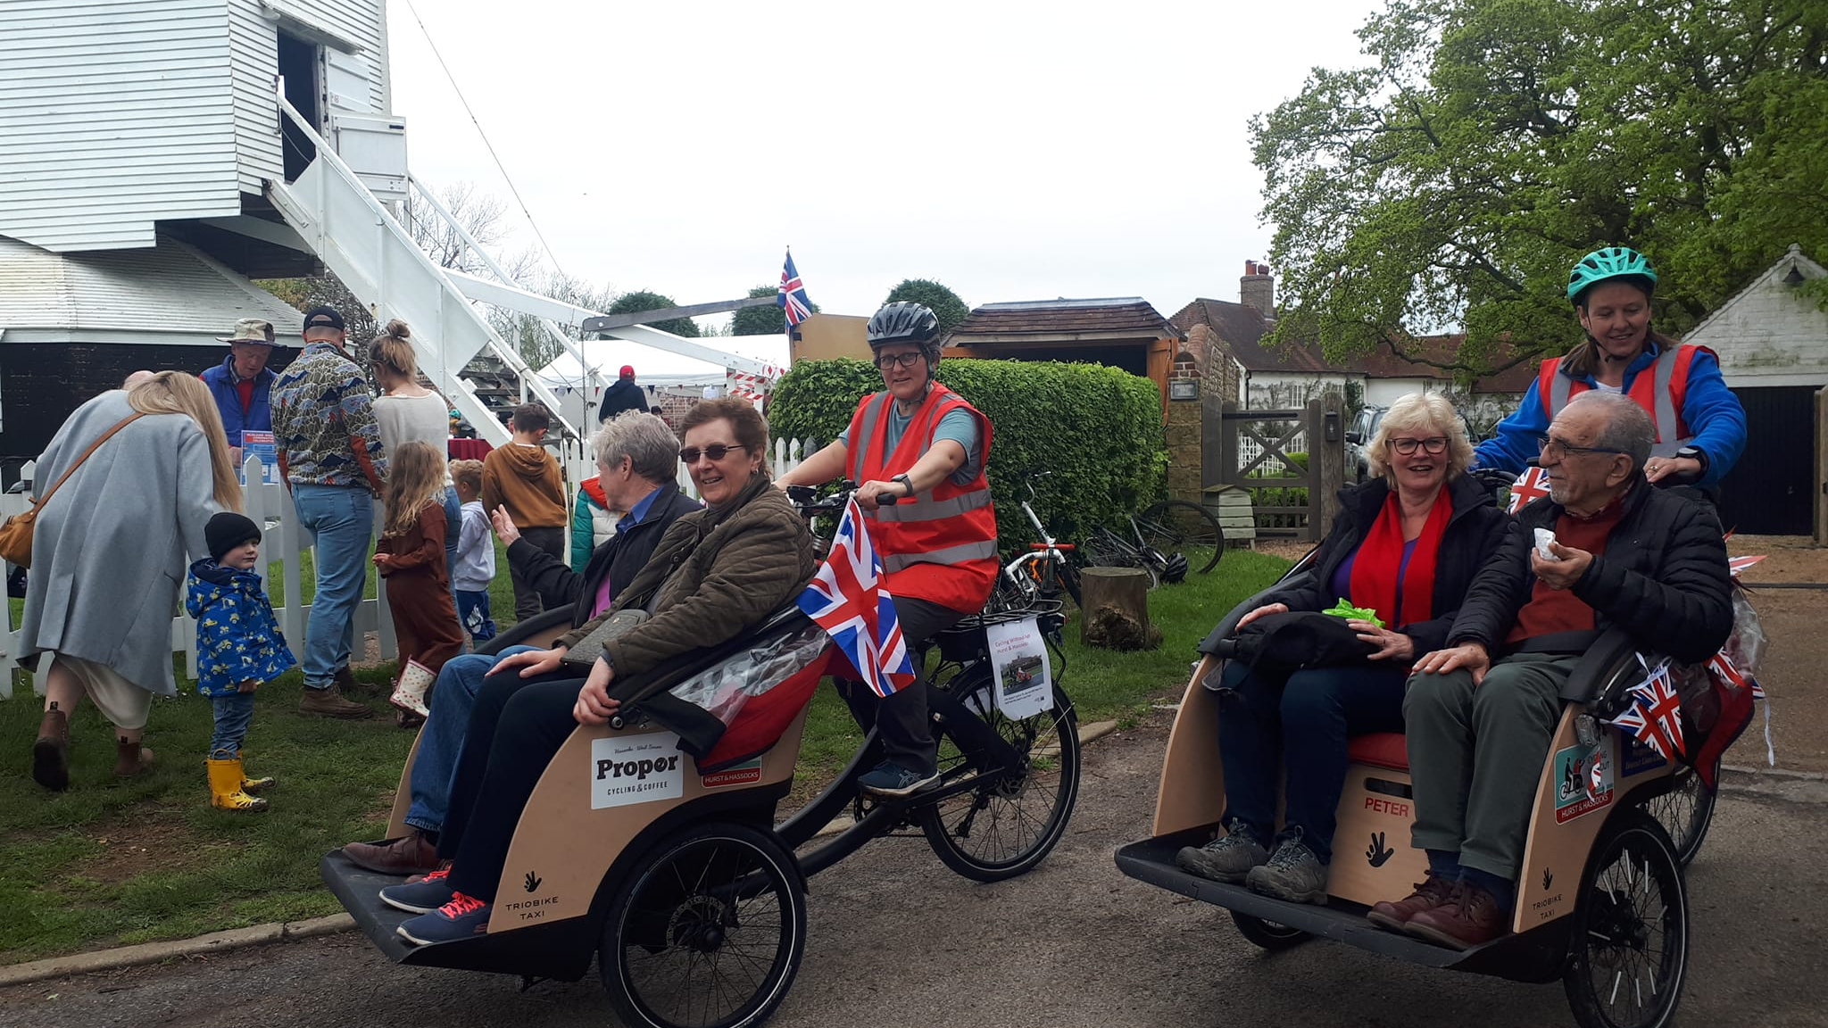

Slide 10
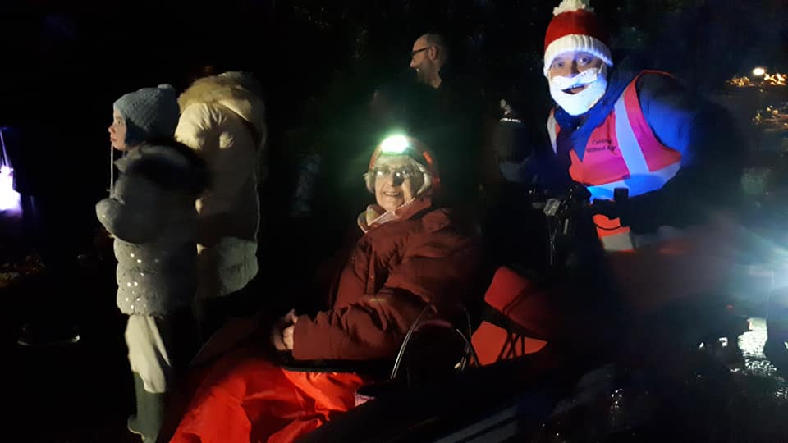

Slide 11
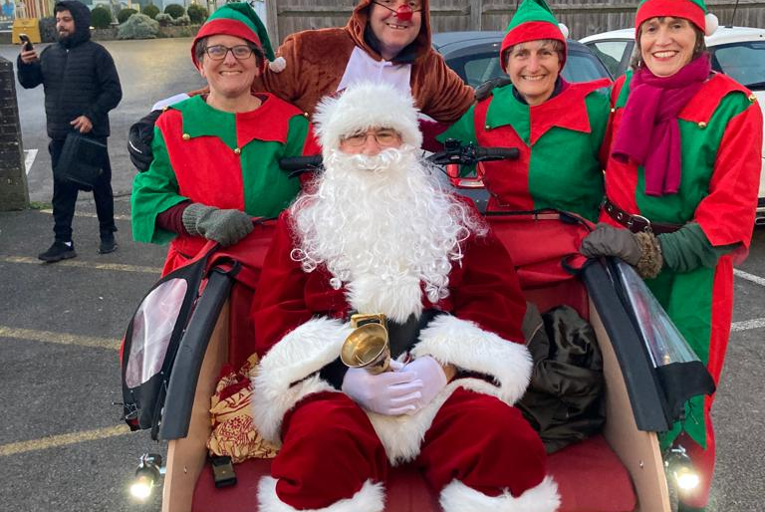

Slide 12
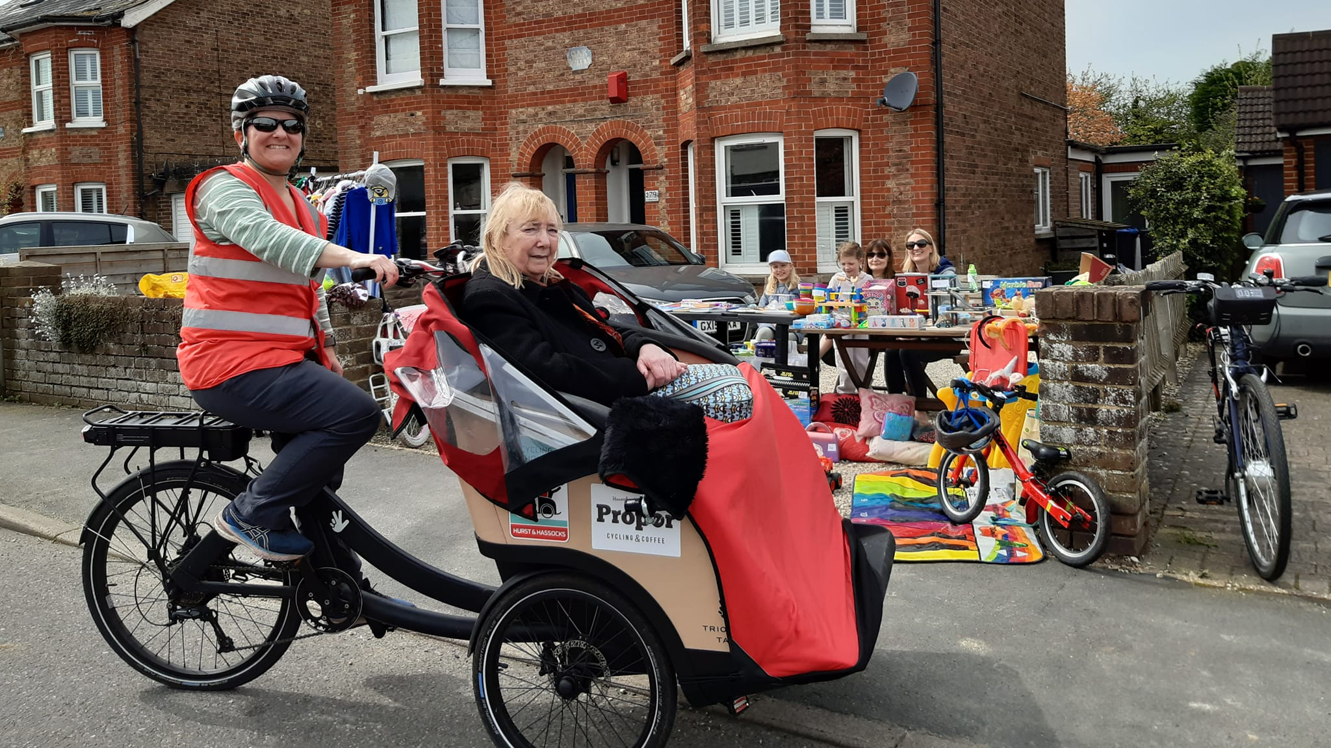

Slide 15
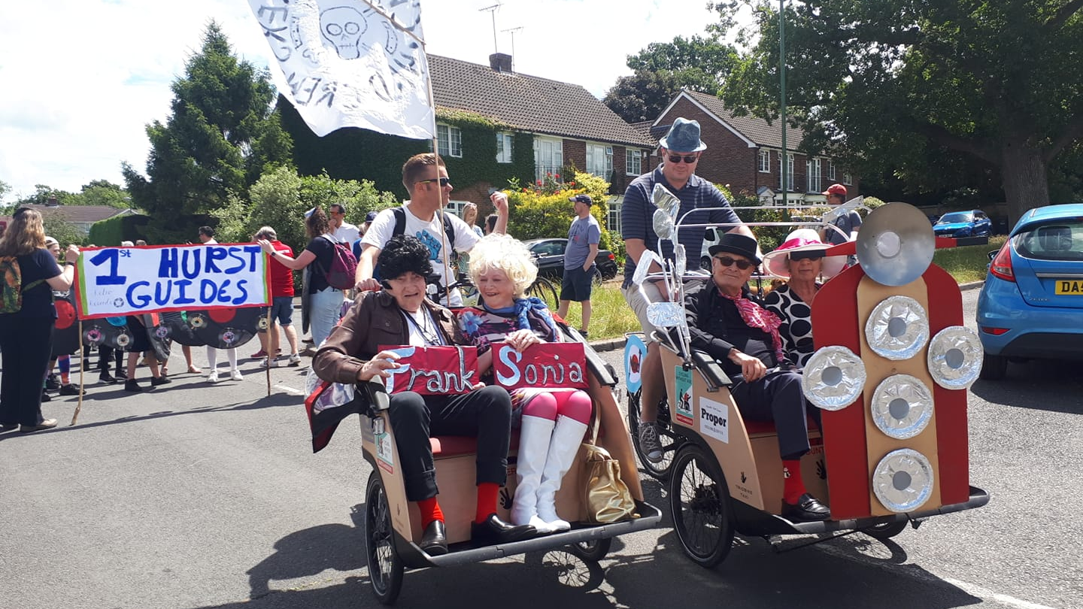

Slide 16
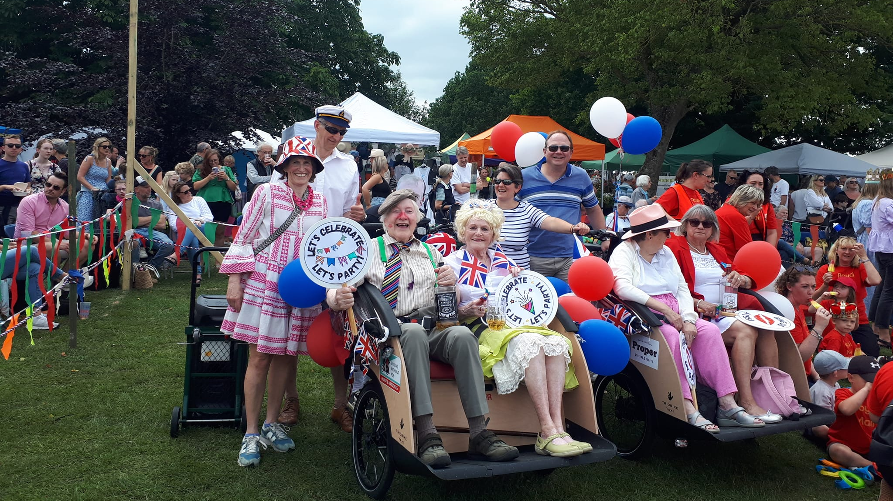

Slide 17
Fair Day!
Hurst & Hassock

Slide 18
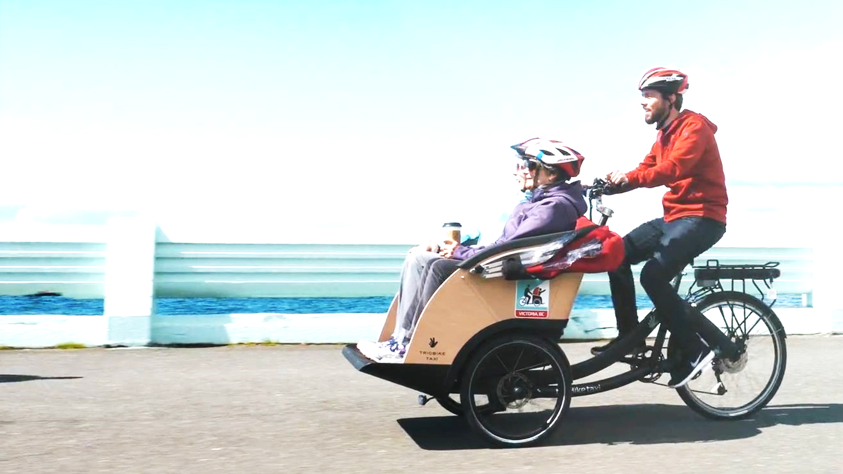
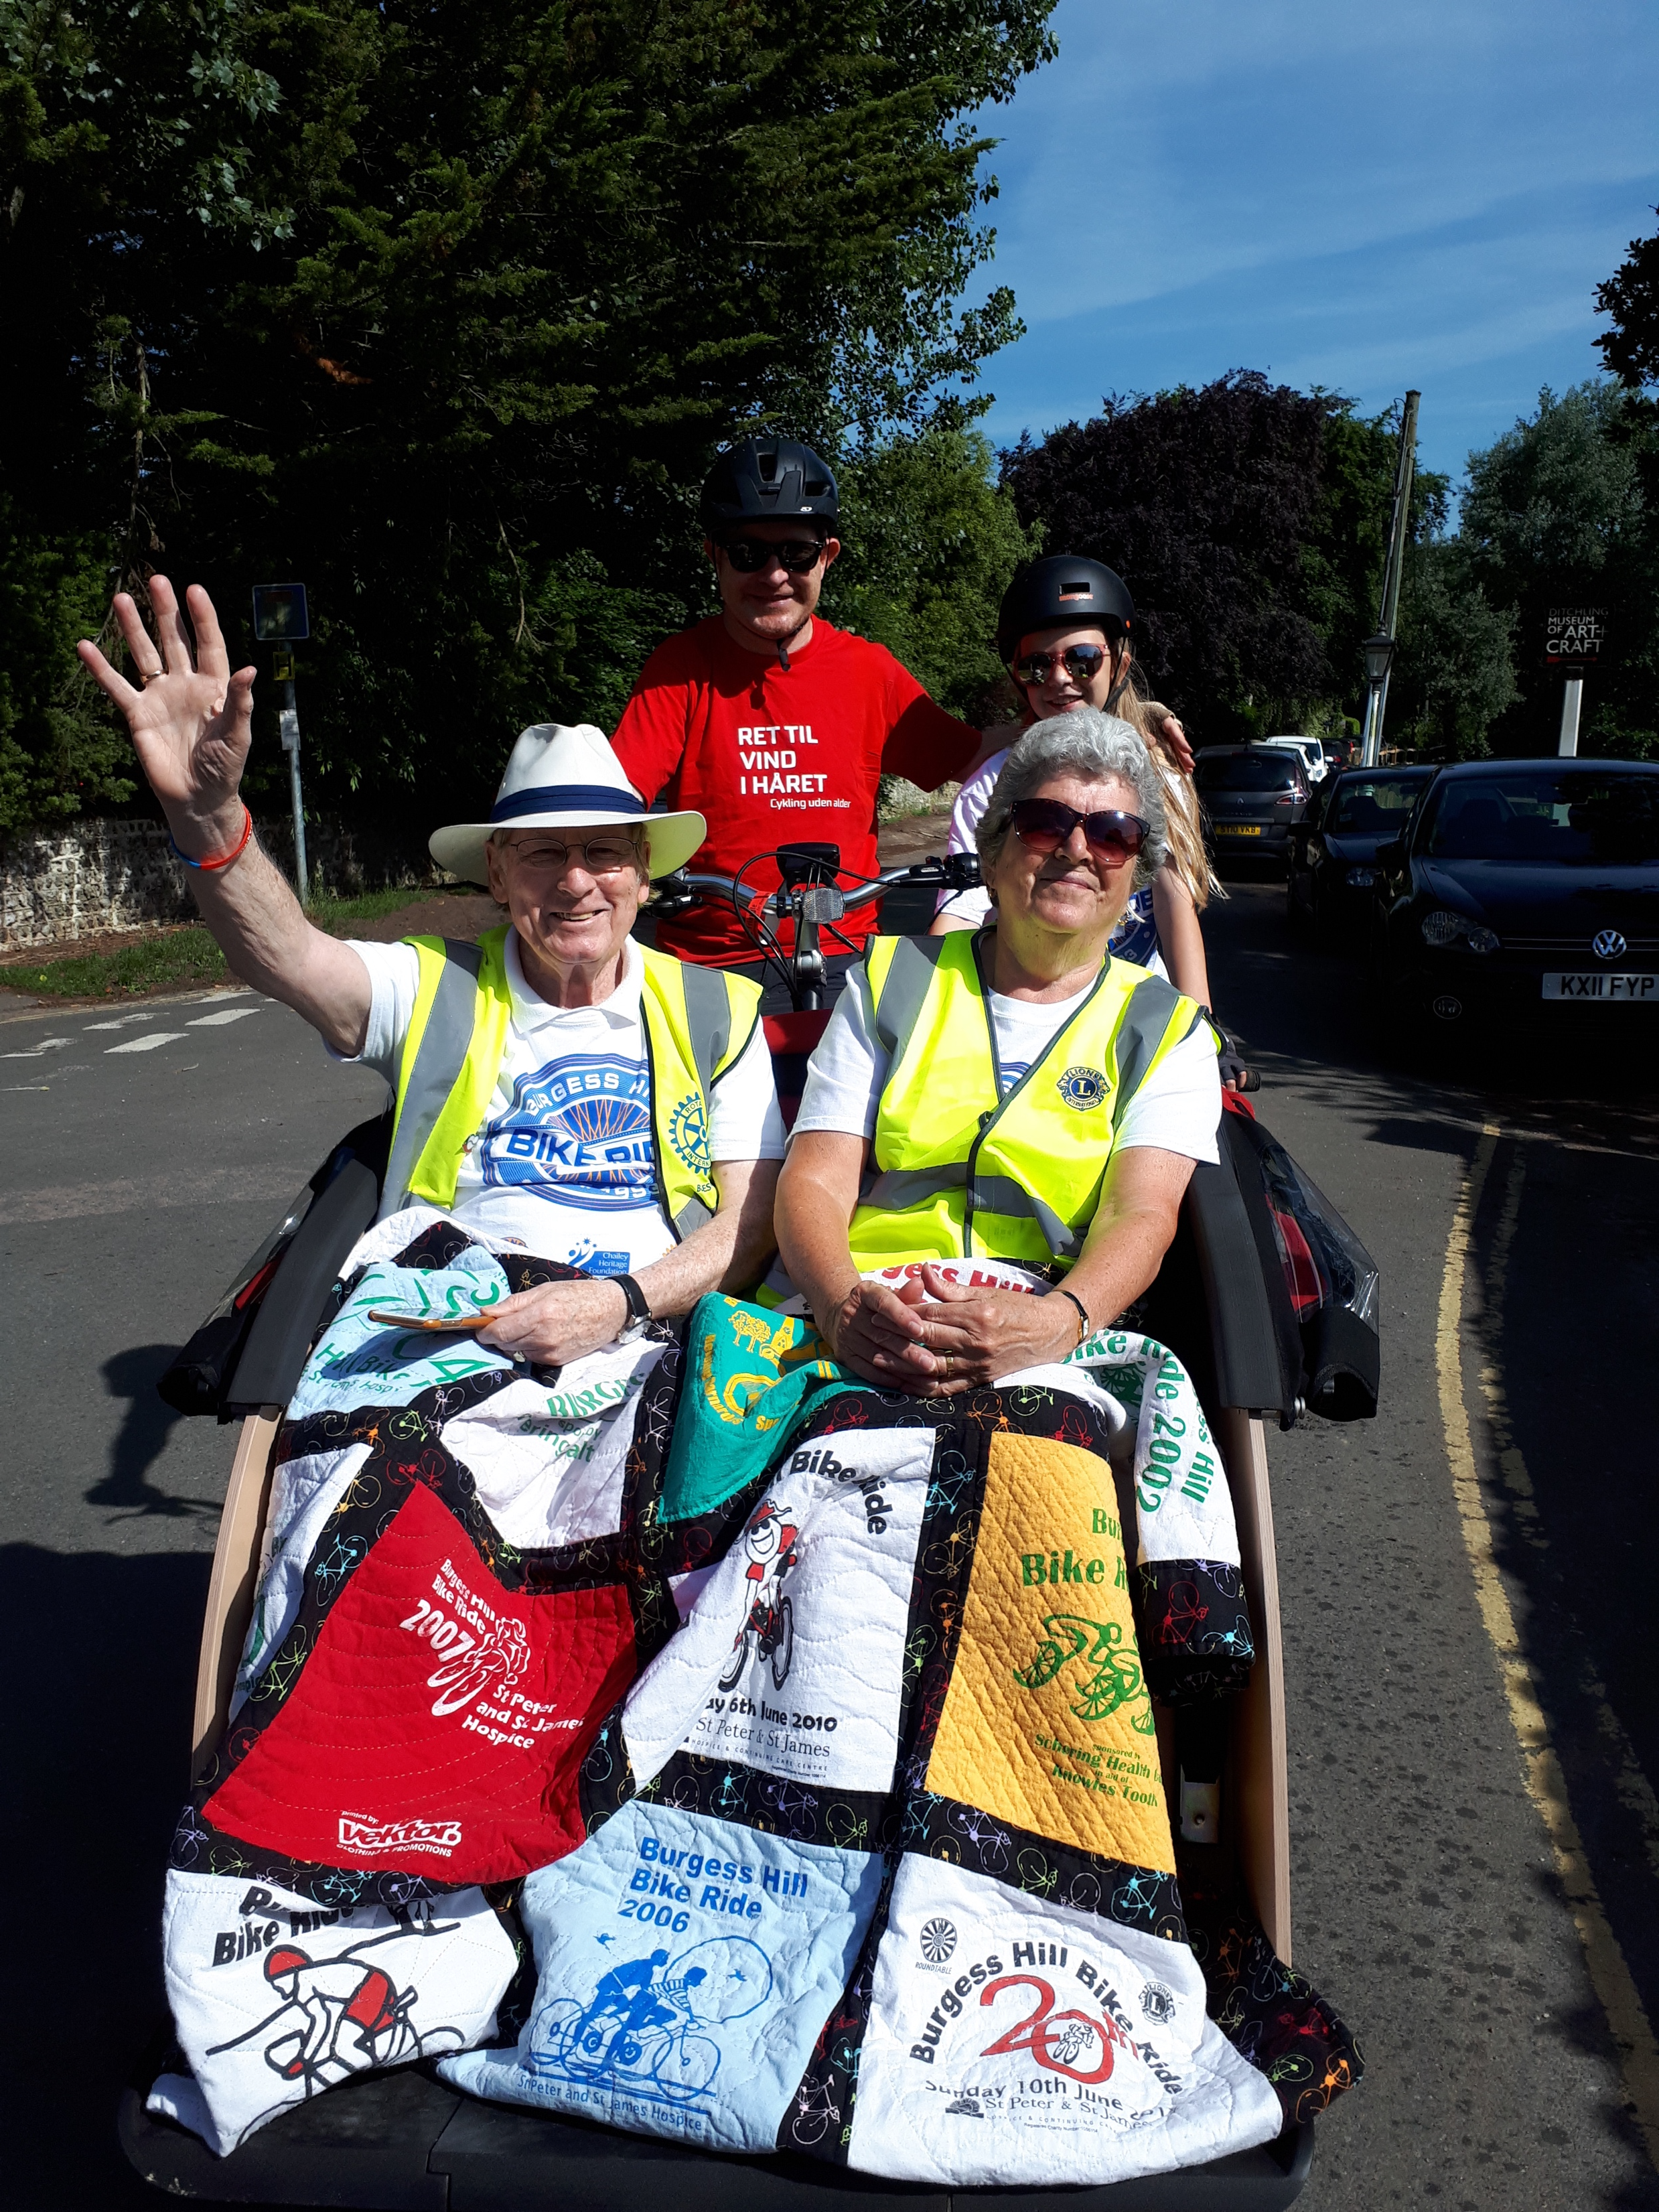
Cycling Without Age
Hurst & Hassocks
Bridget Hamilton
Cycling Without Age
bridget@cyclingwithoutage.org.uk

